Slide 1
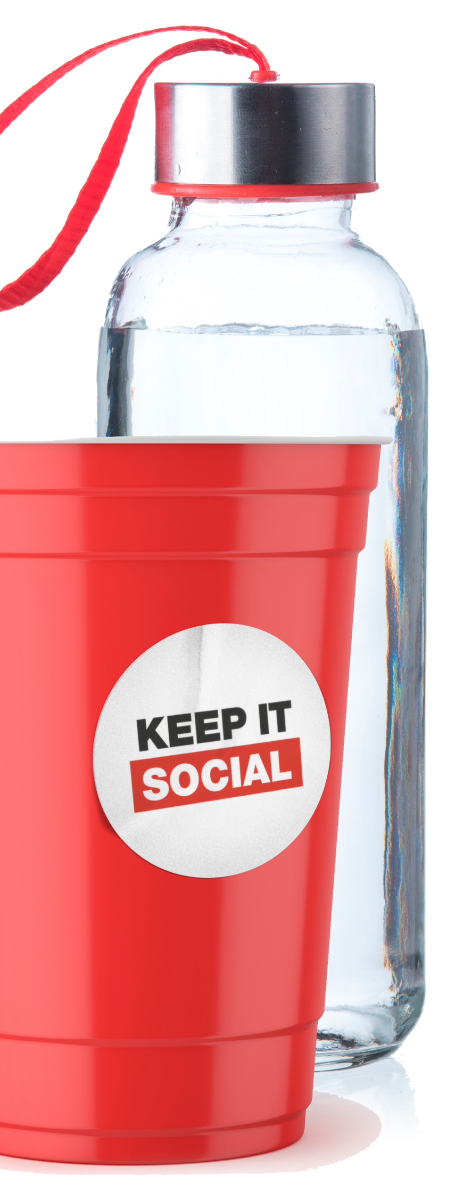
A PRESENTATION GUIDE
FOR STUDENT AMBASSADORS
| Fall 2019

Slide 2
WHAT IS
KEEP IT SOCIAL IS…
A multi-year platform designed to promote responsible consumption and harm reduction of beverage alcohol and recreational cannabis among university and college students
Founded in 2013, the Keep It Social program has been adopted by 13 schools and 5 liquor jurisdictions in Canada
?
| Fall 2019

Slide 3
Promote responsible consumption of beverage alcohol and recreational cannabis
Be student-led, collaborative and sustainable
Gain student leadership commitment
Demonstrate consistent messaging throughout Atlantic campuses (and beyond)
PROGRAM
OBJECTIVES
| Fall 2019
Notes:
Program Objectives
• Promote responsible consumption and harm reduction of beverage alcohol and cannabis among university and college students
• Sustainable, student-led and collaborative
• Gain Student leadership commitment
• Demonstrate consistent messaging throughout Atlantic campuses (and beyond)
Program Components
• Keep it Social provides a platform that can be customized and integrated into each individual campus to comply with alcohol policies and programs.
• Each Campus receives budget based on student enrollment numbers to use towards their Keep It Social program.
• Each campus receives access to digital assets for use on websites, digital screens, etc.
• Student ambassadors who generate ideas and affect messaging and tactics.
LV-what do we mean by “sustainable” in the second bullet point?

Slide 4
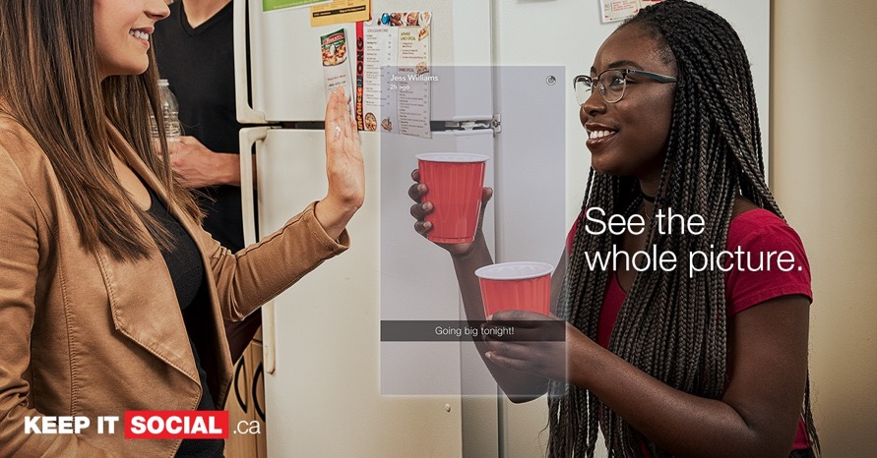
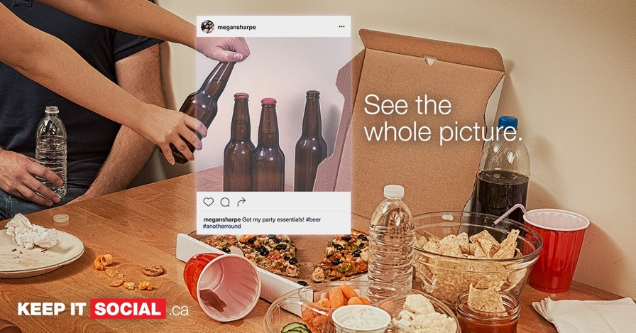
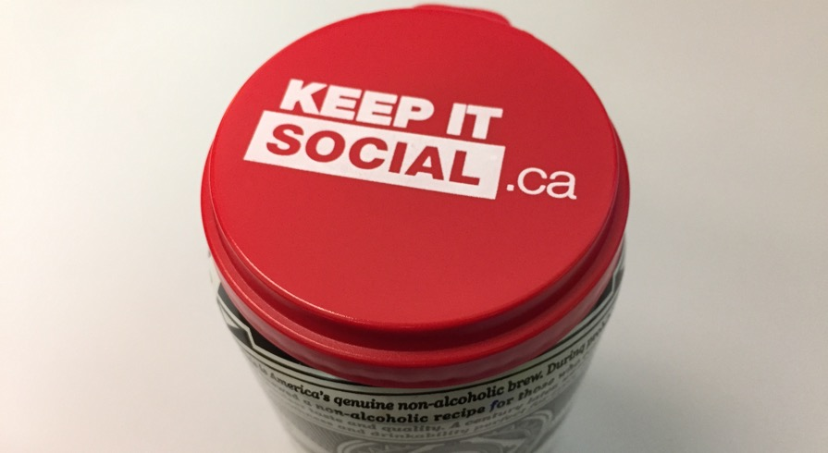
CREATIVE
| Fall 2019
Notes:
Do we want the can topper here? Should use image of pop socket instead.

Slide 5












UNIVERSITY
PARTNERS
| Fall 2019
Notes:
Keep It Social has grown from local Nova Scotia campuses to full Atlantic Canadian participation, and now into quebec.
Acadia
Dal
MSVU
Cape Breton University
St. FX
Saint Mary’s
Universite Saint Anne
UPEI
Memorial
And now Bishops in Sherbrooke, Quebec.

Slide 6
Approach the conversation in an open and upfront manner and participate in the conversation as an equal partner.
Create safe spaces that support and nurture open discussions.
Exhibit the following to be a skilled communicator:
EFFECTIVE
COMMUNICATION
Approachable | Good listener
Trustworthy | Respectful
Non-judgmental | Authentic
Empathetic | Accepting
Understanding | Patient
Experienced
| Fall 2019

Slide 7
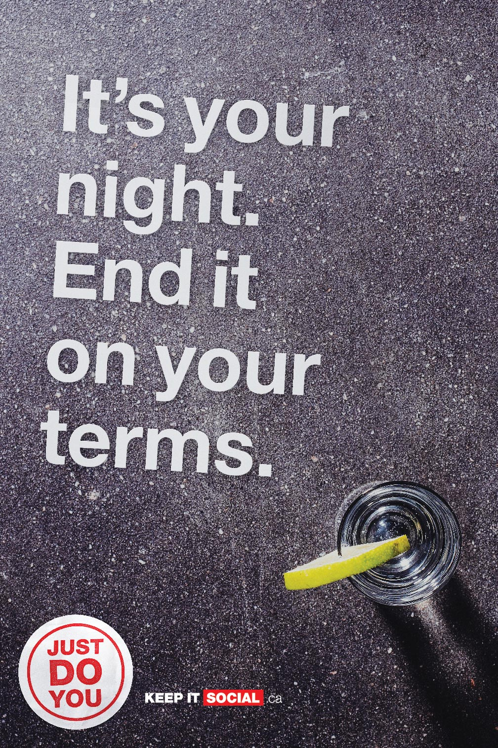
BEVERAGE
ALCOHOL
| Fall 2019

Slide 8
BEER: A beverage alcohol usually made from malted cereal grain (such as barley), flavoured
with hops, and brewed by slow fermentation.
WINE: Fermented fruit juice.
SPIRITS: Liquid containing ethanol and water distilled from a liquid or mash containing alcohol
— often used in plural (such as rum, rye, whiskey, vodka, gin, etc.)
WHAT IS
BEVERAGE
ALCOHOL?
| Fall 2019

Slide 9
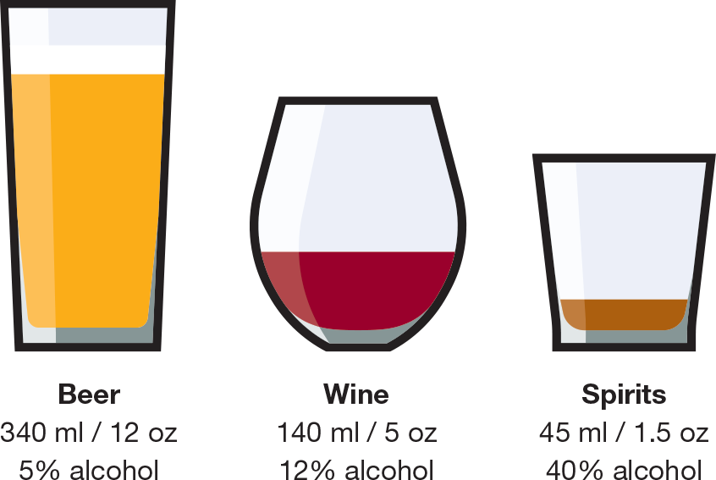
THEY’RE ALL ”A DRINK”
They may look and taste different, but each of
these beverages have the same amount of alcohol. And they’re all considered a standard drink.
WHAT IS A
STANDARD
DRINK?
| Fall 2019
Notes:
Drinking is a personal choice. However, if you choose to drink, understanding what “a drink” means is an important fact to know and helps you keep track of the amount you are consuming.

Slide 10
YOUR LIMITS
Reduce your long-term health risks by
drinking no more than:
10 drinks a week for women, with no more than
2 drinks a day most days
15 drinks a week for men, with no more than
3 drinks a day most days
SPECIAL OCCASIONS
Reduce your risk of injury and harm by drinking
no more than 3 drinks (for women*) or 4 drinks
(for men) on any single occasion
Plan to drink in a safe environment
Stay within the weekly limits
*Trans women and trans men should follow cis women guidelines
CANADA’S
LOW-RISK
ALCOHOL
DRINKING
GUIDELINES
| Fall 2019
KEEP IT SOCIAL | Fall 2019
Notes:
Are we using gender terms?

Slide 11
Set limits for yourself and stick to them
Drink slowly. Have no more than 2 drinks in
any 3 hours
For every drink of beverage alcohol,
have one non-beverage alcohol drink
Eat before and while you are drinking
Always consider your age, body weight and health problems that might suggest lower limits
SAFER
DRINKING TIPS
| Fall 2019
KEEP IT SOCIAL | Fall 2019

Slide 12
SIGNS OF MILD - MODERATE
IMPAIRMENT
Slurred speech
Flushed skin
Difficulty focusing eyes
Reduced impulse control
Silly behavior, giddiness
WHAT TO DO
Assess the student
Provide water to drink
Monitor the student for several hours, do not leave them alone
SIGNS OF SEVERE
IMPAIRMENT
Decreased coordination
Nausea, vomiting
Extreme confusion
Emotional volatility
(anger, violence, sadness)
Drowsiness, sleepiness
WHAT TO DO
Assess the student
Place them in the
recovery position
Call for medical assistance
PROVIDING
ASSISTANCE
| Fall 2019
Notes:
Can we explain here what the recovery position is? Not everyone knows.

Slide 13
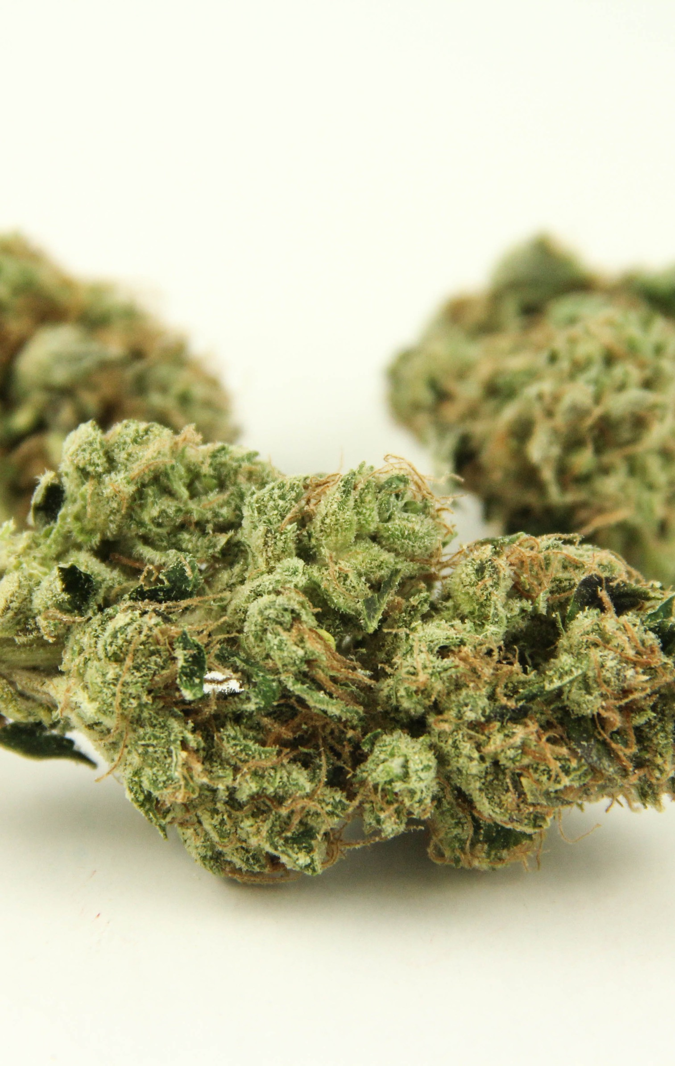
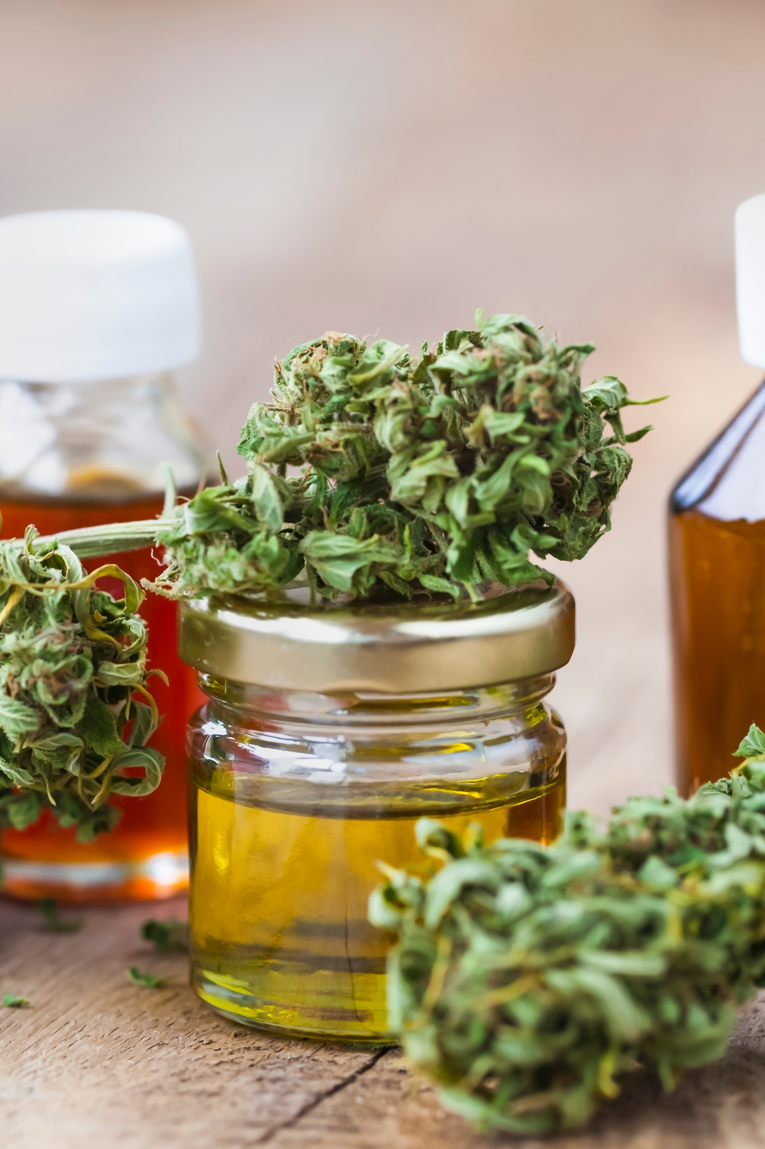
CANNABIS
| Fall 2019

Slide 14
Cannabis refers to a group of plants with psychoactive properties. The flowers of these plants are harvested and dried and used for recreational, medical and industrial purposes. In Nova Scotia, recreational cannabis is sold by the NSLC.
There are three types of Cannabis plants; indica, sativa and hybrids of the two.
Indicas are reported to have more relaxing, sedating effects than sativas
Sativas provide a more euphoric, energized effect
WHAT IS
CANNABIS?
| Fall 2019

Slide 15
Tetrahydrocannabinol (THC) and cannabidiol (CBD) are the two primary cannabinoids that occur naturally in the Cannabis plant. Both of these interact with the cannabinoid receptors found in the human body and brain, but they differ dramatically in their effects.
THC is psychoactive and provides a euphoric feeling once consumed
CBD is non-psychoactive which means that it does not provide a euphoric effect
WHAT IS
THC & CBD?
| Fall 2019

Slide 16
Everybody’s response to cannabis is different, and it can vary from one occasion to the next. It takes longer to feel the effects of eating or drinking cannabis but the effects are often stronger and last longer than when it is smoked or vaporized.
Onset Time for Type of Cannabis consumed
ONSET &
DURATION
Stage | Inhalation | Ingested
Onset | 5–10 minutes | 30 minutes–2 hours
Duration | 5–30 minutes | 4–12 hours
Plateau | 1–2 hours | 1–2 hours
Onset Type | Rapid | Slow
| Fall 2019

Slide 17
Recreational cannabis is now legal in Canada.
Seeds, dried flower and oils are all currently legal
for consumption.
In Nova Scotia, you must be 19 years old or older
to consume recreational cannabis.
The Nova Scotia Liquor Corporation is the only legal retailer of recreational cannabis in the province.
As of October 17, 2019, cannabis edibles, extracts
and topicals will become legal. However, due to regulations, December 16, 2019 will be the earliest date that any of these products will be available
for sale at the NSLC.
WHAT’S
LEGAL?
| Fall 2019

Slide 18
IF YOU ARE 19 YEARS OR OLDER:
You are allowed to have up to 30 grams of dried cannabis (or equivalent) with you in public.
There will be no restrictions on how much
you can keep in your home, as long as it’s
for personal use*.
*You will have to check your university's policy to see allowable possession amounts for campus residences.
You are allowed to purchase the equivalent of
30 grams of dried cannabis per transaction
at the NSLC.
PERSONAL
POSSESSION
AMOUNTS
| Fall 2019

Slide 19

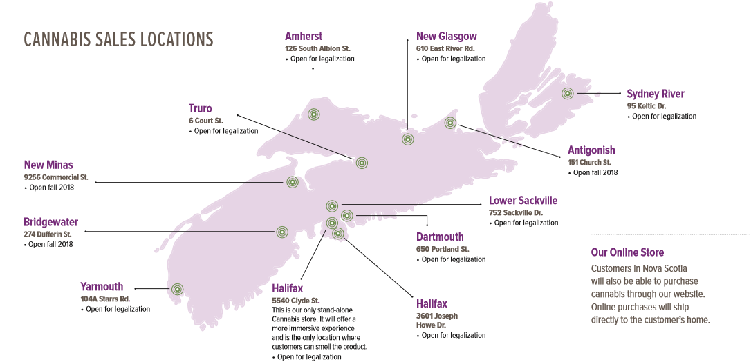
| Fall 2019

Slide 20
24-hour licence suspension for novice drivers (approved drug screening equipment)
24-hour licence suspension for reasonable grounds that the driver is unfit to drive for any reason
7-day licence suspension for a failed Standardized Field Sobriety Test
90-day licence suspension for refusing, a failed drug recognition evaluation, or if you have exceeded the blood per se levels
DRUGGED
DRIVING
SANCTIONS
IN NOVA
SCOTIA
| Fall 2019
Notes:
What are the blood per se levels?

Slide 21
19+ ONLY: In most provinces, the legal age to purchase, consume and possess cannabis is 19.
LOW & SLOW: Onset times vary depending on the method of consumption; it takes longer to feel the effects of cannabis edibles
and drinks compared to cannabis consumed by inhalation. Start with low THC, read product labels for approximate onset times, and wait appropriately to learn how you react.
SEPARATE IS BEST: Beverage alcohol and cannabis both impair judgement. They should be consumed separately as the level of impairment and side effects can be unpredictable when combined.
STORE SECURELY: Store cannabis securely – somewhere that’s locked, out of reach and out of sight of minors.
GET HOME SAFELY: Cannabis impairs your ability to operate a vehicle. Make other plans for transportation, do not drive and get home safely.
RESPONSIBLE
CONSUMPTION OF CANNABIS
| Fall 2019

Slide 22
SIGNS OF CANNABIS
IMPAIRMENT
Red eyes
Decreased coordination
Increased appetite
Delayed reaction times
WHAT TO DO
Assess the student
Provide water and food
Monitor the student for several hours, do not leave them alone
SIGNS OF SEVERE CANNABIS IMPAIRMENT
Paranoia, fear and anxiety
Increased heart rate
Chills/sweats
Disorientation/lack of focus
WHAT TO DO
Assess the student
Provide water and food,
try to get them to relax.
Create a calm and soothing environment
Ask if they’ve consumed anything in addition to cannabis. If they respond they have, seek medical assistance
PROVIDING
ASSISTANCE
| Fall 2019

Slide 23
Beth Martin,
Manager, Corporate Social Responsibility
beth.martin@mynslc.com
902-450-5938

